Slide 1
Sunfish Status
Gunshy Status
Status:
Status:
Runway:
Runway:
Bird Conditon:
Bird Conditon:

Slide 2


Slide 3
 | IN | OUT | REMARKS
ILS | X
VOR | X
DME | X
IGB | X
MEI | X |  | 10 DME Arc
TUP | X
TCL | X
GWO | X

Slide 6
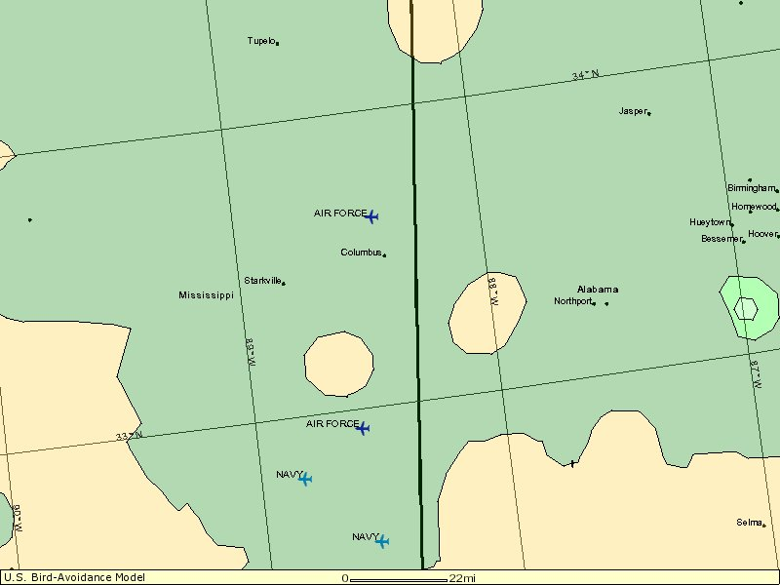
SEV
MOD
LOW
TUP
 | LOW | MOD | SEV
TUP | X
TCL | X
MEI | X
GWO |  | X
GTR | X
SR-137 |  | X
VR-1014 |  | X
CBM
SR137
VR1014
TCL
GUNSHY
MEI

Slide 7
Jets For Sale
Time | Flight
Sims For Sale

